Slide 1


Healthcare Analytics Project
Group 3 Presentation
年号
署名

Slide 2
Healthcare Dataset Overview
• Healthcare dataset contains patient demographics, diagnosis details, treatment records, revenue and visit information.
• Dataset was used to create a complete executive healthcare analytics dashboard in Excel.
• Data includes KPIs, patient visits, treatment outcomes and diagnosis trends for analysis.
• Interactive dashboard helps management monitor operational and financial healthcare performance.
• Dashboard supports faster decision-making using visual analytics and dynamic reporting.
• Used Pivot Tables, slicers, charts and KPI cards for creating interactive reports.

Slide 3
Data Modelling & Relationships
• Created relationships between all 8 tables using unique IDs and lookup keys.
• Connected Patients, Visits, Departments, Diagnoses and Treatments tables together.
• Built a proper data model to support dynamic filtering and reporting across dashboards.
• Relationships improved dashboard accuracy and eliminated duplicate reporting issues.
• Used Excel Data Model and Pivot relationships for advanced reporting functionality.
• Cross-table analysis helped create integrated healthcare business insights.

Slide 4

KPI Overview
• Total Patients analyzed in the dashboard: 10,000.
• Total Visits recorded across all departments: 10,000.
• Completion Rate achieved in treatments: 32.66%.
• Overall Success Rate recorded at 33.01%.
• Total Revenue generated by healthcare operations: 2,540,894.69.
• Chronic Disease Rate reached 80.35%, indicating high long-term care demand.

Slide 5
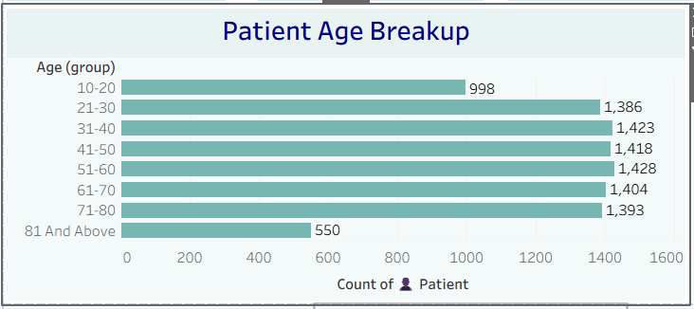
Total Patients Analysis
• Total patient count reached 10,000 across healthcare departments.
• High patient volume reflects strong healthcare service demand.
• Patient data analysis supports operational planning and staffing optimization.
• Helps management identify resource allocation requirements efficiently.
• Patient analytics improve healthcare delivery and service management.
• Dashboard enables better understanding of patient engagement trends.

Slide 6
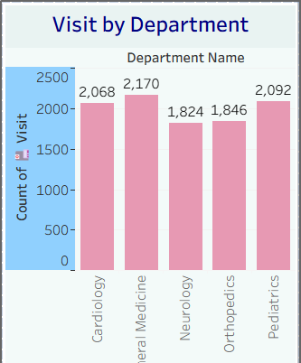
Total Visit Analysis
• Total visits recorded in the system reached 10,000.
• Visit analysis helps monitor hospital utilization and patient activity trends.
• Supports appointment scheduling and workforce planning decisions.
• Visit trends allow healthcare management to improve operational efficiency.
• Higher visit volume indicates strong patient engagement and service demand.
• Dashboard helps executives monitor yearly healthcare utilization patterns.

Slide 7
Completion Rate Analysis
• Completion Rate stands at 32.66% for healthcare procedures and treatments.
• KPI measures the percentage of completed healthcare activities successfully.
• Lower completion rate indicates areas needing operational improvements.
• Better follow-up systems can improve completion performance significantly.
• Completion tracking helps management monitor process efficiency.
• Supports healthcare quality improvement initiatives and reporting.

Slide 8
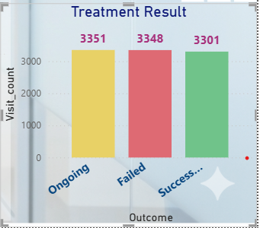
Success Rate Analysis
• Success Rate recorded at 33.01% across healthcare treatments.
• Measures treatment effectiveness and patient recovery outcomes.
• Higher success rates indicate improved healthcare quality and performance.
• Helps departments benchmark treatment efficiency and recovery standards.
• Supports continuous improvement in patient-care management.
• Dashboard provides executives with real-time performance visibility.

Slide 9
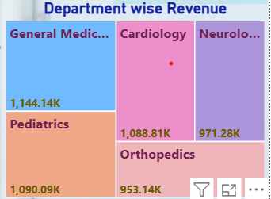
Revenue Analysis
• Total Revenue generated by healthcare services reached 2.54 Million.
• Neurology and Pediatrics departments contributed significantly to revenue.
• Revenue analysis supports budgeting and financial planning decisions.
• Department-wise revenue insights improve operational monitoring.
• Financial analytics help management optimize healthcare investments.
• Dashboard improves visibility into organizational profitability trends.

Slide 10
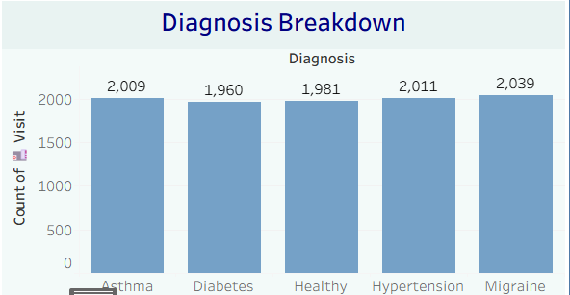
Chronic Disease Rate
• Chronic Disease Rate recorded at 80.35% in the healthcare dataset.
• Indicates a high number of patients requiring long-term treatment and monitoring.
• Chronic illnesses increase operational workload and healthcare expenses.
• Analytics help identify high-risk patients and improve care management.
• Supports preventive healthcare strategies and treatment optimization.
• Dashboard helps management track chronic healthcare demand effectively.

Slide 11
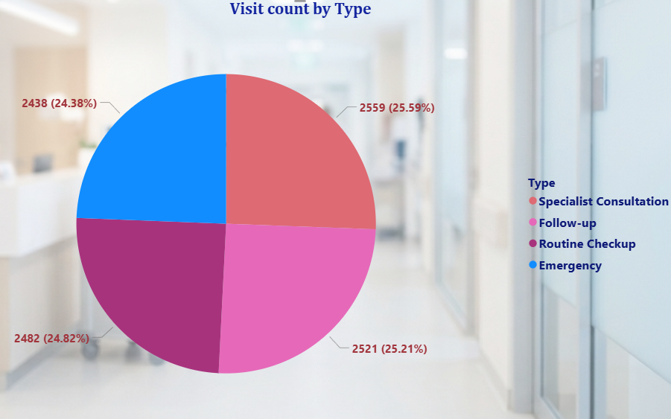
Visit Type Distribution
• Specialist Consultation contributes 26% of total visits.
• Routine Checkups account for 25% of healthcare interactions.
• Follow-up Visits also contribute 25% to overall visit distribution.
• Emergency Visits represent 24% of healthcare operations.
• Balanced visit distribution indicates stable healthcare service operations.
• Visit analysis helps optimize hospital resources and staffing decisions.

Slide 12
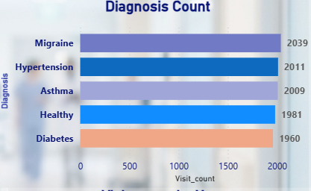
Top Diagnoses by Volume
• Migraine recorded the highest diagnosis volume among all medical conditions.
• Hypertension and Asthma also show significantly high patient counts.
• Diabetes remains one of the major chronic healthcare conditions.
• Diagnosis analysis helps identify major healthcare demand areas.
• Healthcare management can optimize resources using diagnosis trends.
• Dashboard supports data-driven clinical and operational planning.

Slide 13
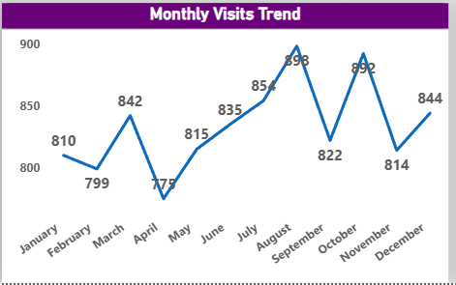
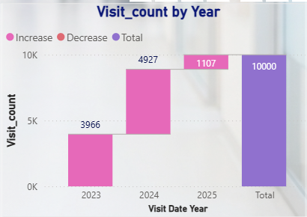
Monthly Visit Trend
• Patient visits increased significantly from 2023 to 2024.
• 2024 recorded the highest healthcare visit volume in the dashboard.
• 2025 trend shows decline because of incomplete yearly data collection.
• Trend analysis supports forecasting and workforce planning decisions.
• Visit trends help management understand long-term healthcare demand.
• Dashboard enables year-wise performance monitoring and analysis.

Slide 14
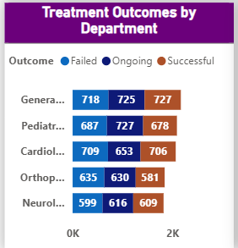
Treatment Outcomes Breakdown
• Ongoing Treatments recorded: 3351 cases.
• Failed Treatments recorded: 3348 cases.
• Successful Treatments recorded: 3301 cases.
• Treatment outcome analysis helps improve healthcare quality standards.
• Monitoring failed treatments supports operational improvement initiatives.
• Dashboard helps management track patient recovery performance effectively.

Slide 15
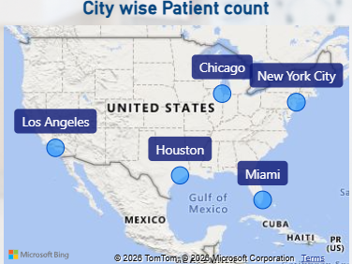
Patient Distribution by State
• Texas recorded one of the highest patient counts in the dataset.
• State-wise analysis identifies healthcare demand hotspots effectively.
• Regional insights support healthcare expansion and planning decisions.
• Geographic trends improve resource allocation and operational management.
• Patient distribution analysis helps identify underserved regions.
• Dashboard supports strategic healthcare service planning.

Slide 16
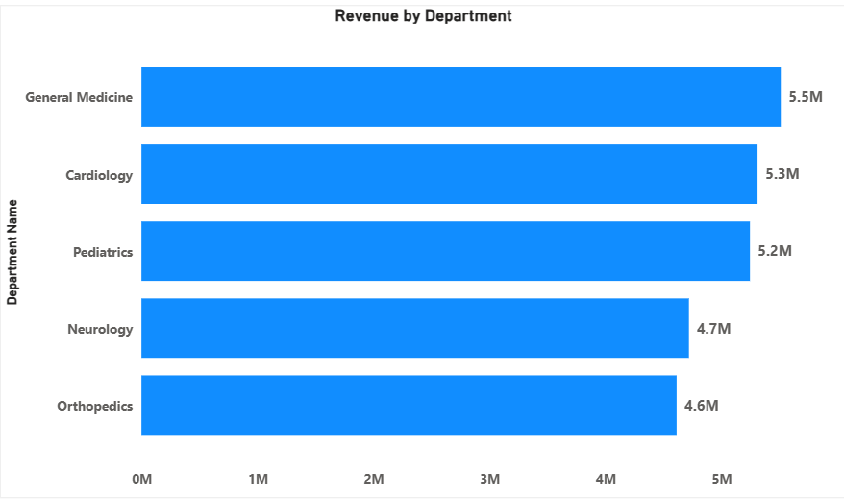
Revenue by Department
• General Medicine generated one of the highest revenue contributions.
• Pediatrics and Cardiology also showed strong financial performance.
• Department-wise analysis improves healthcare financial monitoring.
• Revenue insights help identify high-performing healthcare departments.
• Financial reporting supports budgeting and strategic planning decisions.
• Dashboard improves visibility into departmental business performance.

Slide 17
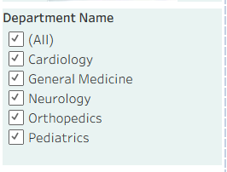
Department Filter Analysis
• Dashboard includes interactive slicers for department-level analysis.
• Departments include Cardiology, Neurology, Orthopedics and Pediatrics.
• Dynamic filtering improves reporting flexibility and usability.
• Drill-down analysis helps management explore detailed department insights.
• Interactive reporting supports faster executive decision-making.
• Dashboard enhances overall business intelligence capabilities.

Slide 18
Visit Year Analysis
• Dashboard supports analysis for years 2023, 2024 and 2025.
• Year-wise filtering helps identify healthcare growth trends clearly.
• Annual comparisons improve operational and financial planning decisions.
• Trend analysis supports forecasting and workforce management.
• Helps executives monitor long-term healthcare performance effectively.
• Dashboard improves strategic reporting and planning efficiency.

Slide 19
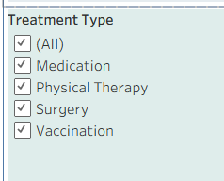
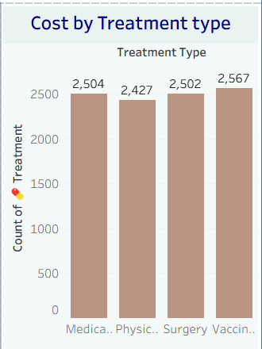
Treatment Type Analysis
• Treatment filters include Medication, Surgery, Vaccination and Physical Therapy.
• Treatment-wise analysis improves healthcare service monitoring.
• Helps management compare treatment demand and performance trends.
• Interactive filtering supports detailed patient-care analysis.
• Dashboard improves operational visibility into healthcare services.
• Treatment insights support strategic healthcare planning.

Slide 20
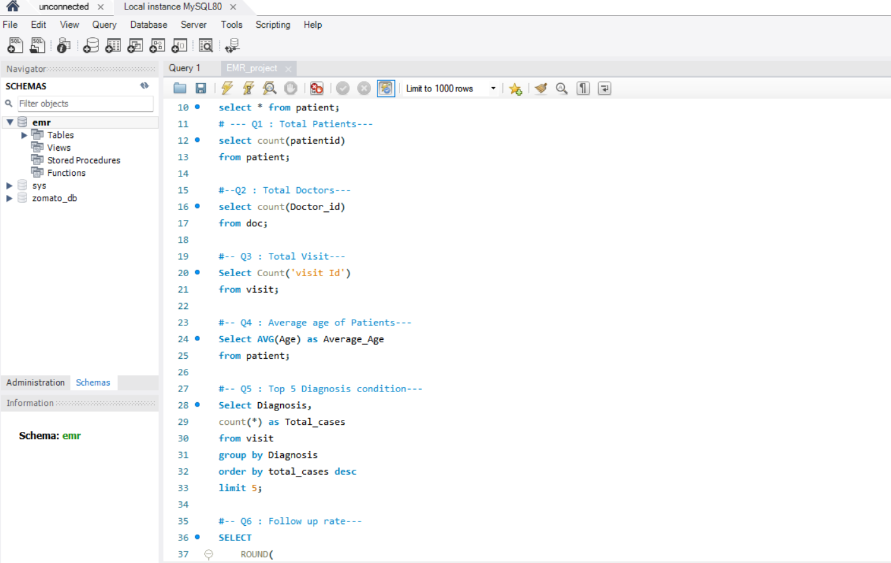
SQL Analysis
From Fragmented Excel Files to Centralized SQL InsightsData Centralization
Migrated separate Excel spreadsheets (Patients, Visits, Billing) into a single, structured MySQL database.Relational Modeling.
Connected flat files into a relational schema using Primary & Foreign Keys to ensure data integrity.
Advanced Querying: Executed complex Multi-Table Joins and conditional aggregations (GROUP BY) to eliminate manual data filtering.
Key Deliverable: Generated unified, query-driven datasets tracking patient outcomes, hospital stay lengths, and billing trends.

Slide 21
Project Summary
• Healthcare dashboard combines KPIs, charts, slicers and business insights together.
• Built using Excel dashboarding, Pivot Tables and data modelling techniques.
• Dashboard supports operational, financial and strategic healthcare decisions.
• Interactive visuals improve reporting speed and executive visibility.
• Healthcare analytics improve patient care quality and operational efficiency.
• Project demonstrates strong business intelligence and Excel dashboarding skills.

Slide 22
Thank You
Priyanka
Navdeep
Parnavi
Riyaz

